Slide 1

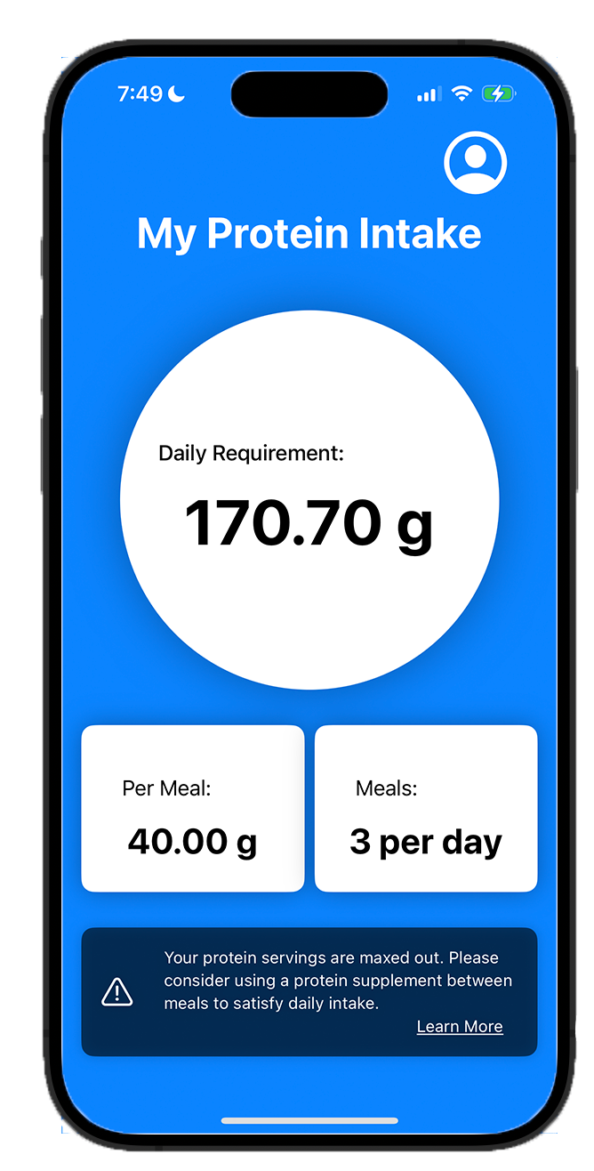
My Protein Intake
An app by Eddie Diaz

Slide 2
Why measure protein intake?
}
Muscle growth
Muscle repair
Better aging
Disease Recovery and Convalescence
Athletic performance
Varies between
individuals

Slide 3
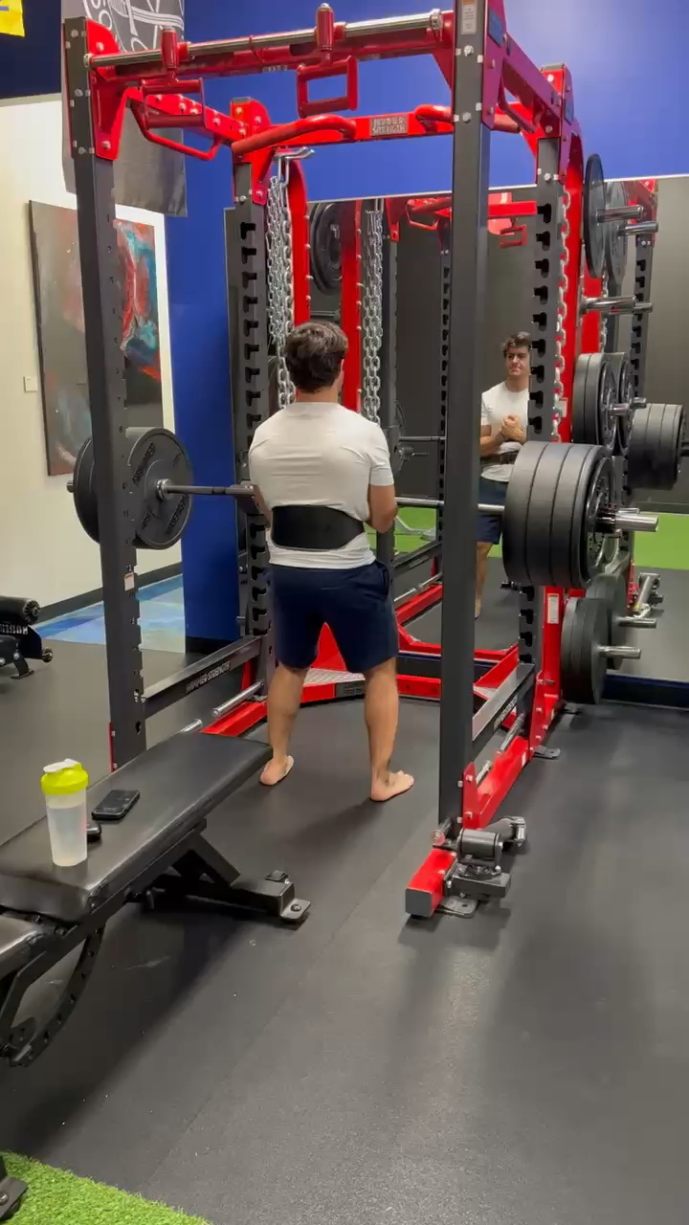
About the creator
SMU MS Computer Science and Engineering Entrepreneurship
Full-Stack Developer since 2020
NASM Certified Personal Trainer
NASM Certified Nutrition Coach
Former semi-pro rugby
Entrepreneur in the fitness industry
Gained 20 pounds of muscle in < 6 months

Slide 4

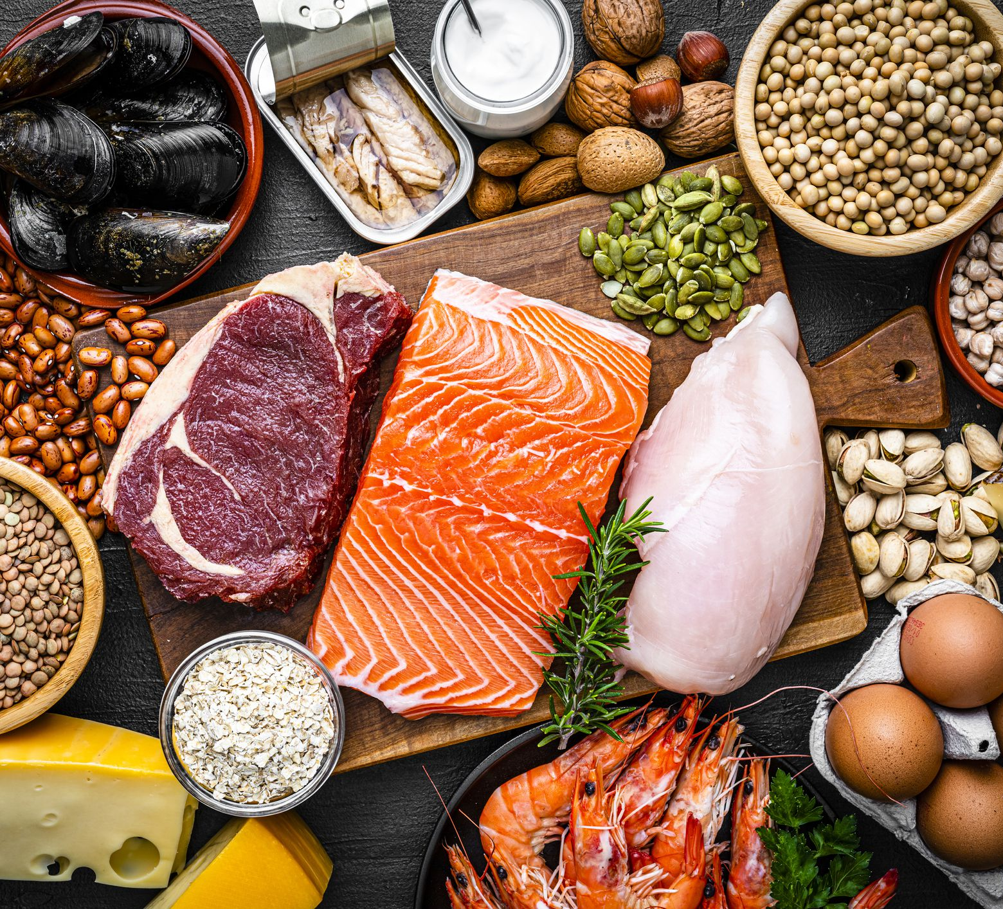
Things to consider
BMI: height & weight
Gender
Pregnancy
Job type
Goals
Activity Level
Self- reported
iPhone – Core Motion

Slide 5
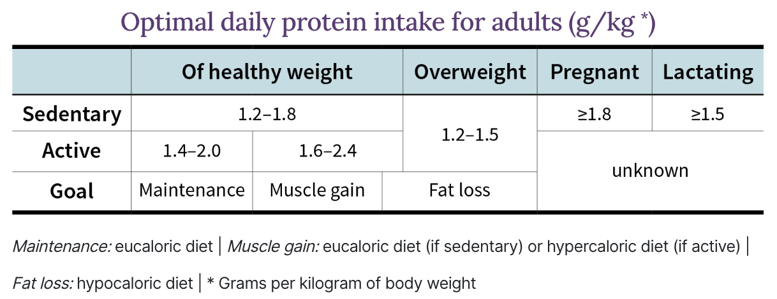
Source: https://examine.com/guides/protein-intake/

Slide 6
How it works
App collects data from CoreMotion and User Input
TensorFlow model predicts a level of activity and sends prediction to app
From 0 (Sedentary) to 4 (Very Active)
Training based on a set of assumptions, not real data *
Activity Levels provide the baseline g/kg of intake
Further individualization is done within the iPhone app
BMI will account for a 20% increase or decrease depending on health recommendation
Women receive 20% less intake unless reported pregnant
Training goal also yields 20% more for Muscle Gain or 20% less for Fat Loss

Slide 7
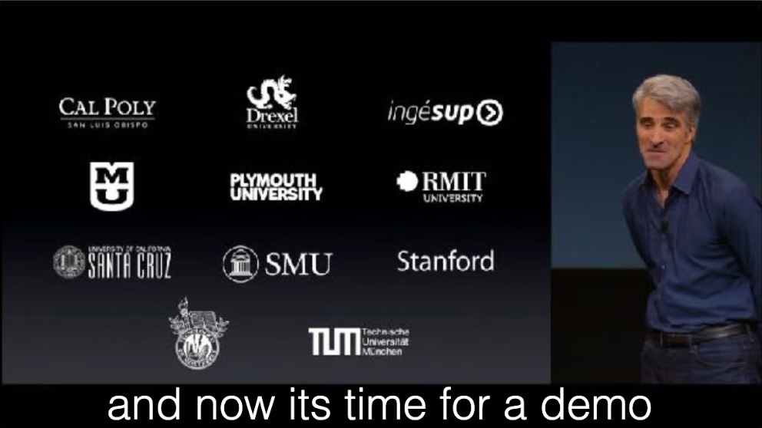
Questions

